Slide 1
Business Documents:
Table of Contents

Slide 2
Table of Contents (TOC)
Purpose of Table of Contents:
used to accompany a report, document, or manuscript to list the topics and sub-topics in the order in which they occur.
Example of use of a TOC:
Chronological listing with page numbers of
contents of an accompanying research report

Slide 3
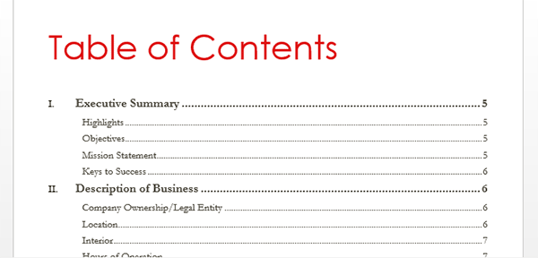
Table of Contents Example

Slide 4
3 Components of Table of Contents (TOC)
Title/Heading (is called Table of Contents)
Description/List of Topics and Subtopics (Includes respective page numbers)
Page Number – (Roman Numeral style at the bottom of the page)

Slide 5
TOC Notes
A table of contents may be prepared using the software’s automatic feature or manually
The content of the table of contents is a list of each element of the report or document following the table of contents

Slide 6
Table of Contents Formatting Guidelines
Change Margins: Top=2, Bottom=1, Left=1, Right=1
Change Line Spacing = Single Space
Center the heading Table of Contents in all caps and bold
Double or triple space after the title
Set a right dot leader tab (6.5)
Subtopics within a topic should be indented an additional .5 spaces from the left
Include a page number in roman numeral format in the bottom center of each page
OTHER FORMATTING GUIDE LINES
Key the topics corresponding page number in the right margin
Double space all entries (Press Enter twice)
Key each element at the left margin
Single space multiple-line entries
Key entries in initial caps
Use a double or triple space before the appendix listing on the table of contents
Double space the items at the end of the report, such as the appendices and bibliography

