Slide 1
Personal & Transferable Skills
1.03 – Career Decisions

Slide 2
Essential Question
What do skills and ability say about who I am?
We will discuss two categories of skills:
Personal Skills
Transferable Skills

Slide 3
Personal Skills
Personal Skills
Mental
Physical
Social

Slide 4
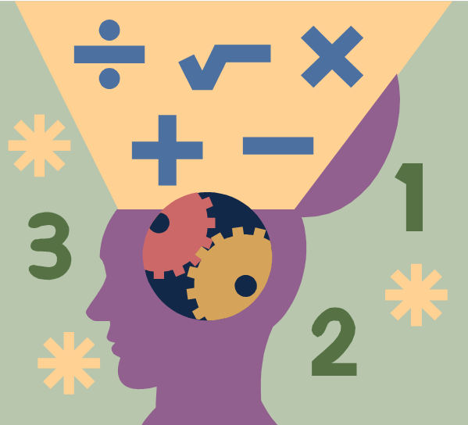
Mental skills:
Mental skills - are skills we can be trained to learn. Mental skills help us concentrate, set goals, use our imagination, allows us mentally rehearse different things, clear our mind and relax, deep concentration, and self-talk?
Our mental skills help us learn difficult things
Help us to concentrate and accomplish goals
Mental skills help us understand whatever we read
Learn mathematics – Algebra, Geometry, Calculus, Trigonometry
Learn sciences – Biology, Chemistry, Physical Sciences, Environmental Sciences
Learn foreign languages – Spanish, French, Italian or German
How to clear our mind from aggravating issues and relax
Develop our reading and writing skills
Learn football

Slide 5
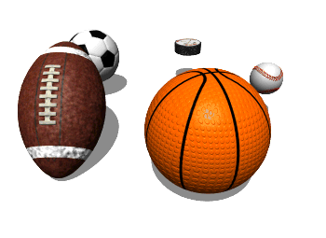
Physical Skills
Physical skills refer to an individual’s ability to perform any form of physical activity like walking, running, bicycling, gardening, football, basketball, dancing, swimming etc
Strength
Stamina (endurance)
Flexibility
Quickness

Slide 6
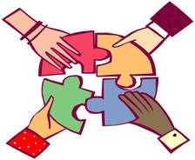
Social Skills!
Social skills training" is a general term for instruction conducted in (behavioral) areas that promotes more productive/positive interaction with others.
Social skills – having the ability to act in an appropriate manner that reflects, maintain, and enhances a person’s positive interpersonal (between people) effects.
Social competence: one's overall social functioning; a composite or multitude of generalized social skills.
Social competence can be improved by teaching social behaviors/social skills

Slide 7
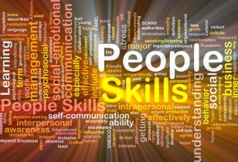
Social Skills
Manners and positive interaction with others
approaching others in social acceptable ways
asking for permission rather than acting
making and keeping friends
sharing toys/materials
Appropriate classroom behavior
work habits/academic survival skills
listening
attending to task
following directions
seeking attention properly
accepting the consequences of one's behavior

Slide 8
Social Skills
Better ways to handle frustration/anger
counting to 10 before reacting
distracting oneself to a pleasurable task
learning how to cool oneself down and reflect upon the best course of action
Acceptable ways to resolve conflict with others
using words instead of physical contact
seeking the assistance of the teacher or conflict resolution team

Slide 9
Transferable Skills
Transferable skills:
the skills you acquire and transfer to future employment settings.

Slide 10
Transferable Skills
Communication skills – speaking and writing
Listening skills – sending and receiving messages
Problem-solving skills - handling conflicts
Technology skills – computer knowledge
Decision-making skills – making wise decisions
Organizing and planning skills - time management
Teamwork skills - working with team members
Adaptability skills – adjusting to change

